Slide 1
Master Engineering Systems
Master track
Sustainable Energy
Description
May 2020

Slide 2
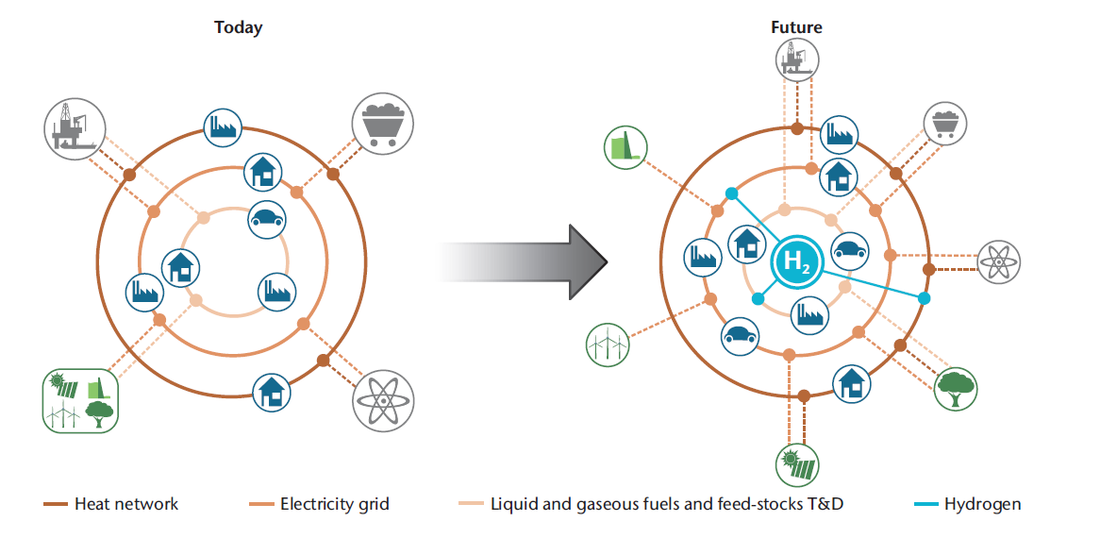
Energy transition
Before
Source: Technology Roadmap – Hydrogen and Fuel cells; IEA, 2015

Slide 3
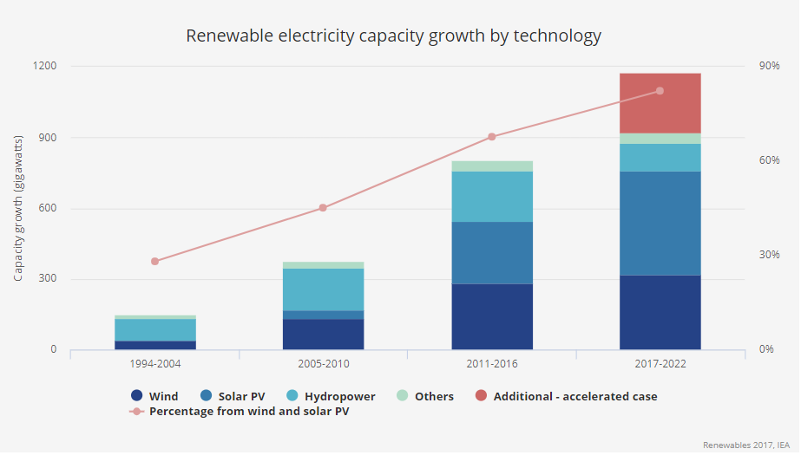
Sustainable energy growth (technology)

Slide 4
A sustainable sustainable energy system?
Sustainable energy production technology available
How to match intermittent production vs energy demand – in time and location?
Increase/regulate/adjust/develop:
energy production
energy distribution
energy consumption
energy storage/buffering

Slide 5
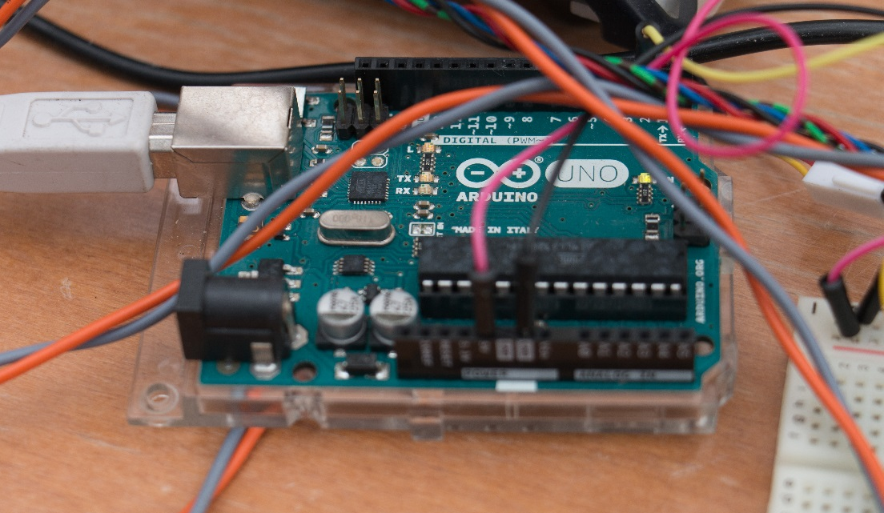
Engineering challenges!
need for new clean-tech energy-innovations
design, construct and validate technical solutions
implement smart applications
socio-economical consequences
reliable – sustainable – achievable – affordable

Slide 6
Potential job options
• Energy engineering analyst
Works for an electricity supplier on activities such as procurement, supply chain and management coordination. Evaluates the implementation of renewable energy initiatives and impact on existing infrastructure. Assembles and releases engineering design packets and identifies and leads process improvements. Assists with production and transmission equipment and facility testing programs.
• Renewable Energy Asset Manager
The asset manager may work for an energy supplier or a renewable energy project operator. You will manage renewable energy infrastructure and projects from a technical, commercial and financial perspective. In addition, you may support the development and construction of new projects, as well as quality inspections and advice in the field of insurance claims and contracting.
• Energy System Engineer
The energy system engineer works for instance for an SME developing renewable energy technology as part of an engineering team. The Engineer participates in the design and development of energy components and/or systems meeting all functional targets. This involves amongst others design, modelling, building, testing and validation of hardware and controls.
• Energy Consultant
The energy consultant works for a consultancy company and is responsible for the expert technical review of renewable energy projects, assessment of renewable energy components and technology and advise and report to clients.

Slide 7
More information
For more information or any questions regarding this Master Track, feel free to contact us at:
sustainable.energy@han.nl
We hope to see you at the start of our next study year!

