Slide 1
HAN SCHOOL OF ENGINEERING AND AUTOMOTIVE
Mastertrack
‘Smart Automotive’
Modules Smart Vehicles & Smart Infrastructure

Slide 2
Track ‘Automotive – smart’: intelligent mobility
The goal of this Track: Educating technical young professionals in the Intelligent Mobility domain, with attention to the roles of both private and public parties.
Reason for developing this Track: There is a high demand for people with in-depth knowledge of intelligent mobility technologies. They will be able to successfully make connections between today's technology and problems and the possibilities of intelligent technologies in the future.
What type of specialists do we educate: Broadly oriented technical engineers who can act as the bridge in the complex and changing mobility domain.

Slide 3
The 2 modules within the intelligent mobility track
Smart Vehicles (15 ECTS) | Smart Infrastructure (15 ECTS)
Vehicle technology Sensor Technologies; Vehicle automation (inc. ADAS); Embedded systems; Functional safety Talking Traffic Transmission protocols; IoT; 4G 5G G5 Wifi P; cybersecurity Societal and behavioural impact Human-Machine interfaces and interaction; (engineering) ethics in mobility domain; privacy and legal aspects | Multi-Modal Traffic Management Transportation modes; Infrastructure; Logistics; Asset Management; Mobility as a Service; Interoperability; Big Data Governance of innovation processes Public administration and processes of governing innovation Societal and Behavioural Impact Traffic psychology and sociology related to infrastructure; privacy and legal aspects

Slide 4
intelligent mobility Module – Smart vehicles
Structure of the module of Smart Vehicles (1 semester)
Term 1:
Weakly lectures from proffesionals from the field
Introduction in the Minor Project & Capita Selecta
Examination: Written exam
Term 2:
Partly lectures & guiding Minor Project work
Examination: Written exam, Capita Selecta report & Minor Project report + presentation

Slide 5
intelligent mobility Module – Smart Infrastructure
Structure of the module of Smart Infrastructure (1 semester)
Term 1:
Weakly lectures from proffesionals from the field
Introduction in the Minor Project & Capita Selecta
Examination: Written exam
Term 2:
Partly lectures & guiding Minor Project work
Examination: Home-Taken exam (assignment), Capita Selecta report & Minor Project report + presentation

Slide 6
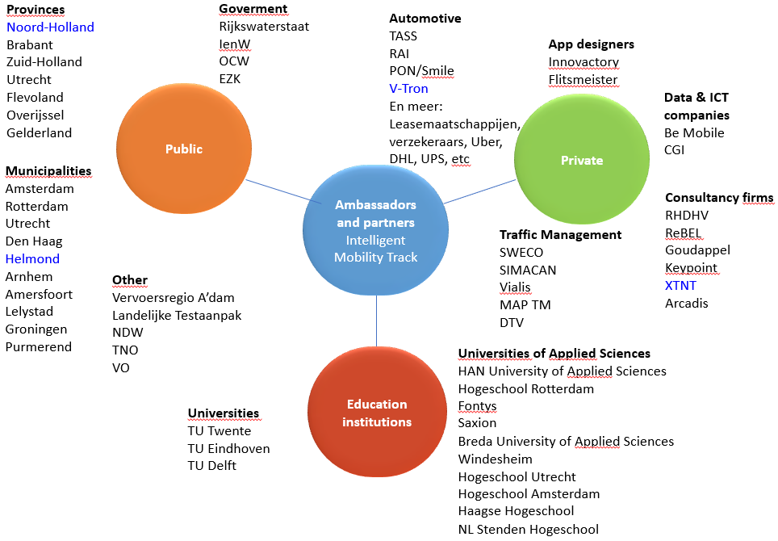
Stakeholder map Mastertrack Intelligent Mobility

Slide 7
More information & contact
Smart Vehicles:
https://www.youtube.com/watch?v=kTk6BERaVqE
Smart Infrastructure:
https://www.youtube.com/watch?v=QqfalWomFQg&t=104s
Contact Information:
Frans Tillema Frans.Tillema@han.nl
Chris Huijboom Chris.Huijboom@han.nl
Marith Dieker Marith.Dieker@han.nl
Bas Hetjes Bas.Hetjes@han.nl
Gijs van Stekelenburg Gijs.vanStekelenburg@han.nl
Rakshith Kusumakar Rakshith.Kusumakar@han.nl

