Slide 1
MES
Electric, Hybrid and Fuel Cell Powertrains
Aishwarya Aswal
Ad Oomen

Slide 2
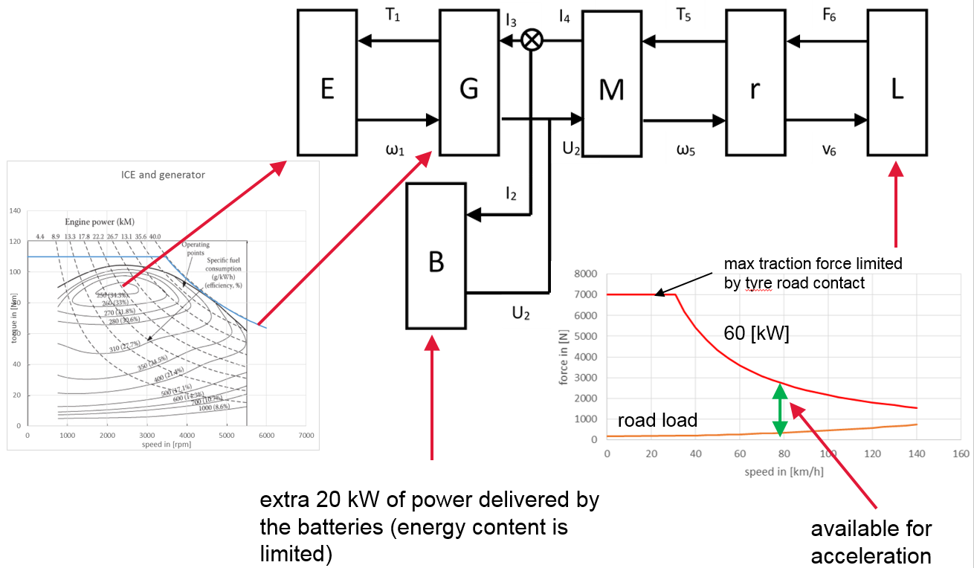
professional task
Understand, analyze and contribute to innovations in Power Trains
hybrid

Slide 3
course structure
theory:
  lectures
  modeling assignment in AMEsim
minor project
capita selecta (link with minor project)

Slide 4
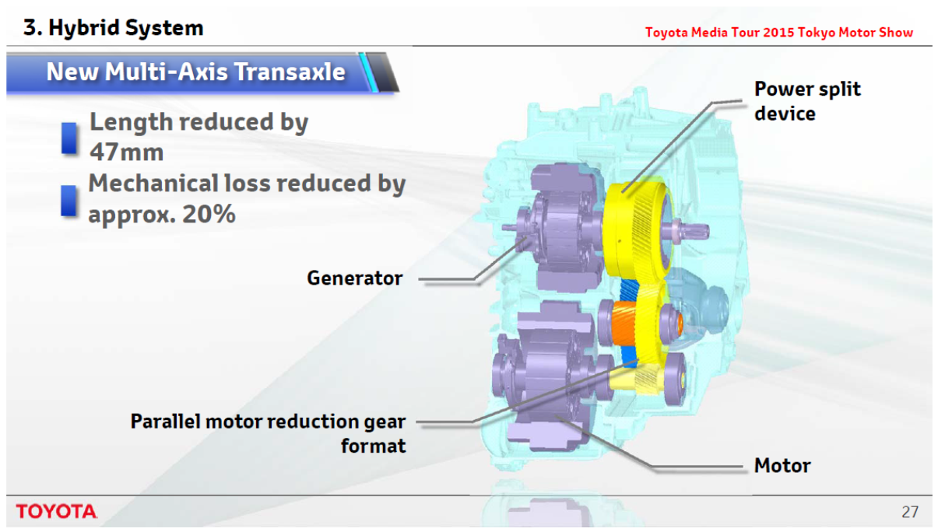
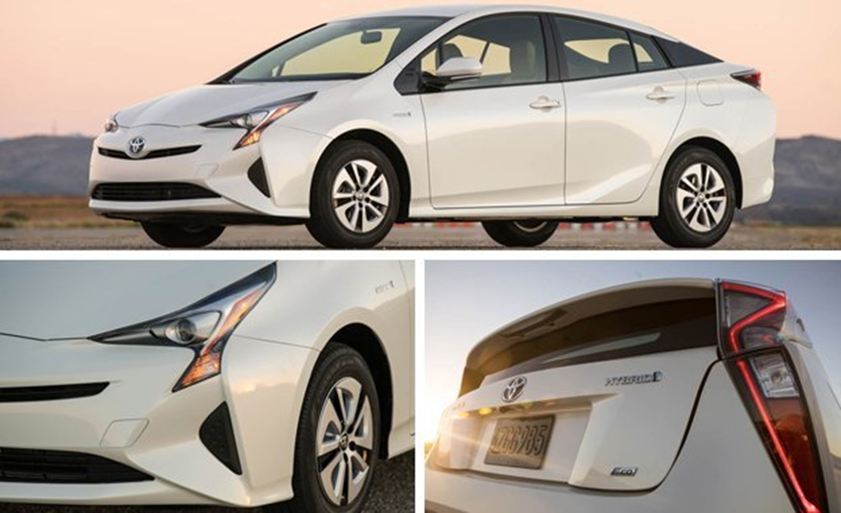
Theory: Content EHFP lectures term 1
fundamentals and modeling:
  Why do we need intelligent powertrains?
  Fundamentals and definitions
  Components of hybrid drivelines
  Backward modeling of drivelines (4-pole).

Slide 5
Theory: Content EHFP lectures term 2
Power flow in hybrid drivelines and energy management
  Fundamentals of e-motors
  Hybrid drivelines
  Energy management

Slide 6
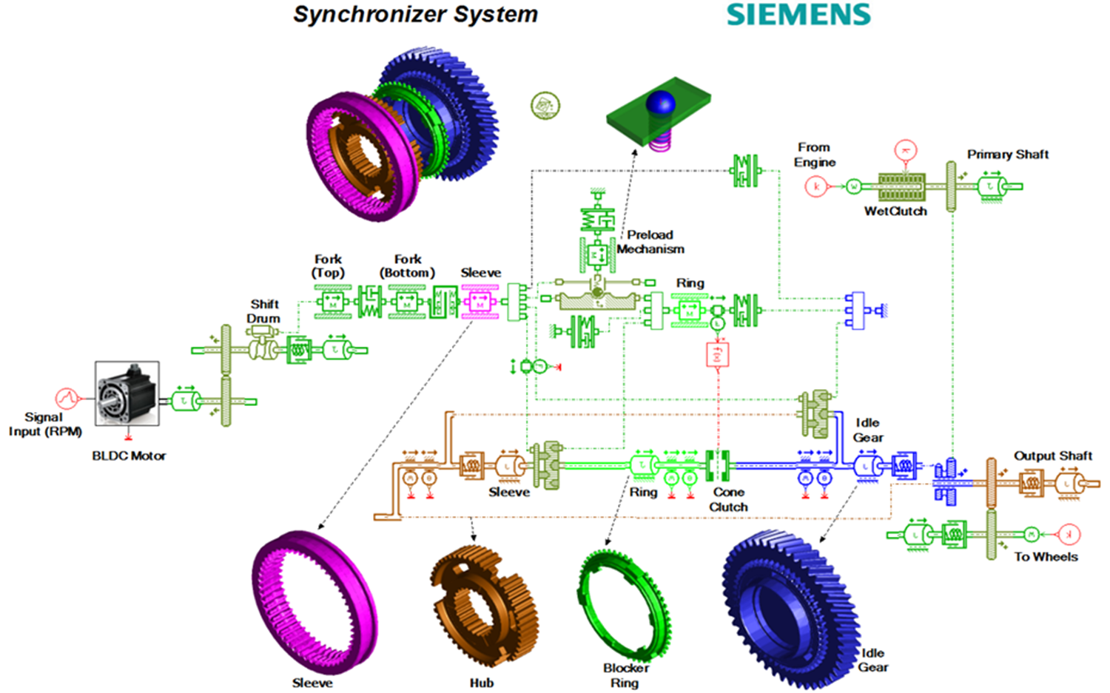
Theory: AMEsim assignment
AMEsim: modeling of an intelligent driveline

Slide 7
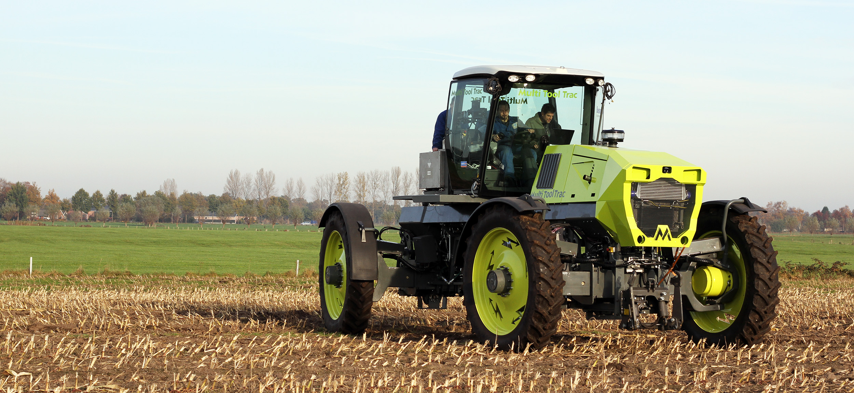
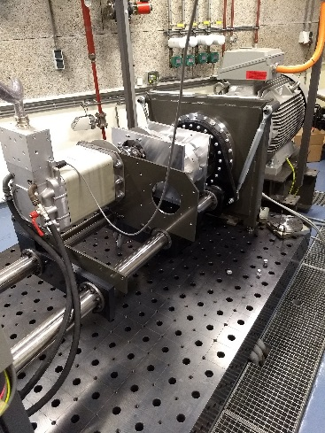
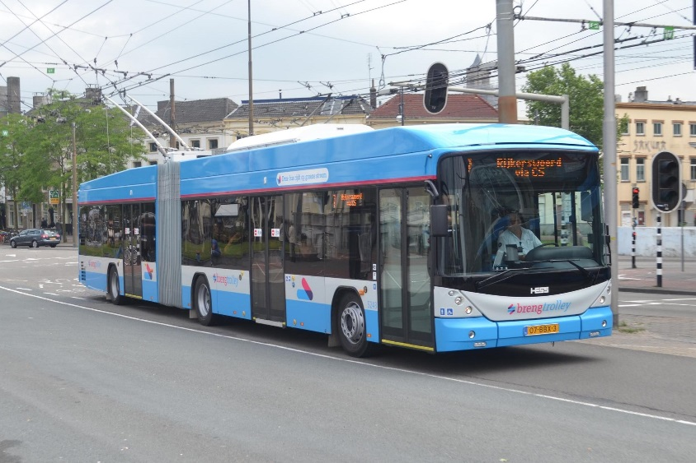
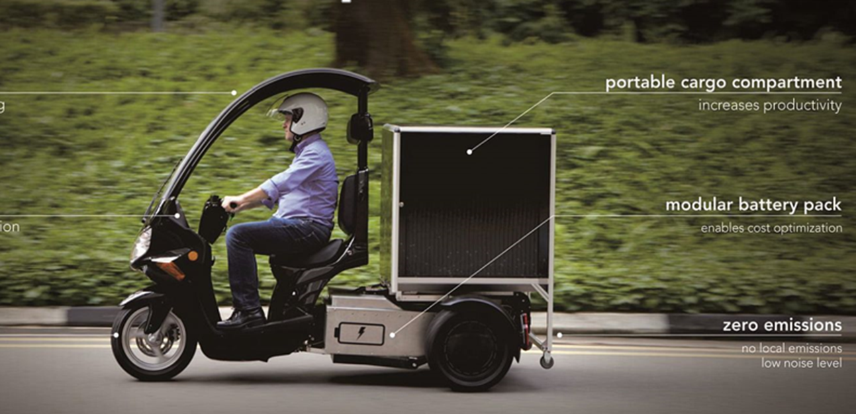
Minor projects

Slide 8
Capita selecta
Study of peer reviewed paper(s)
Related to the minor project

Slide 9
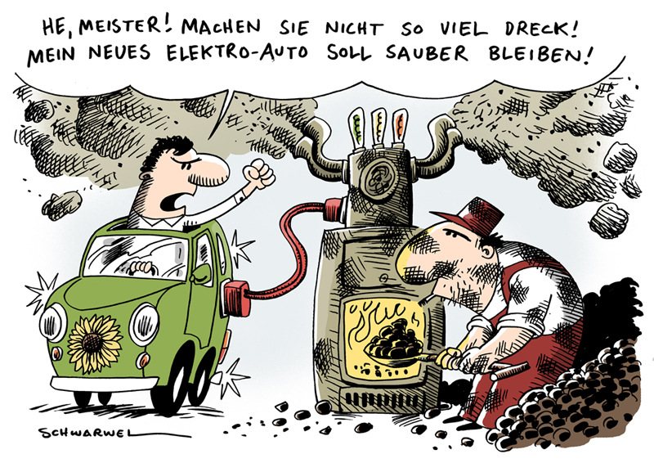
Well to wheel needs to be included
https://www.mycomics.de/comic-pages/1866-sauberes-elektro-auto-faehrt-mit-schmutziger-energie.html#page/1/mode/1up

